Slide 1
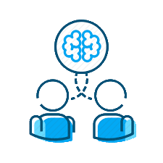
Two Heads
Are Better Than One
Why you should try pair programming
Tonya Cooper
Notes:
Hi, thanks for coming! I’m Tonya Cooper and I’m a software engineer at Quicken Loans. Today I’m going to talk to you about why I think your team will benefit from pairing and how you can work pair programming into your development process.

Slide 2
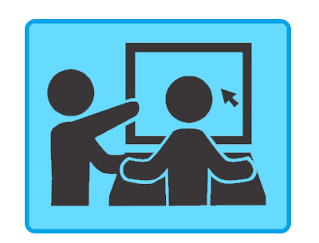
My first time pairing
Notes:
One year ago, I joined a team that pairs. I had never worked on a team that paired and, I was uncomfortable with the idea.
But I was very excited about this new opportunity, so I set aside my reservations and tried it. . . .

Slide 3

My first time pairing
Notes:
And, I didn’t like it. I didn’t like it at all. I felt chained to the desk, to the person I was pairing with. Syncing our schedules was annoying. I missed programming alone and getting into the zone. Pairing felt like a waste of time.
So how did I get from that place to being an advocate of pairing? Well it took time and some small but important adjustments to how we paired.

Slide 4
I got there… you can too
Notes:
I got there and you can too.
To talk through it, today we will discuss:

Slide 5
I got there… you can too
Common problems
Notes:
Common problems that pair programming addresses

Slide 6
I got there… you can too
Common problems
Why developers don’t want to pair
Notes:
Typical reasons developers don’t want to pair and how to overcome them

Slide 7
I got there… you can too
Common problems
Why developers don’t want to pair
Pairing styles
Notes:
Picking the best pair programming style to fit your team

Slide 8
I got there… you can too
Common problems
Why developers don’t want to pair
Pairing styles
Tips and best practices
Notes:
Tips and best practices for getting the most out of a pairing session

Slide 9
I got there… you can too
Common problems
Why developers don’t want to pair
Pairing styles
Tips and best practices
How to get started
Notes:
How you can get started

Slide 10

The Interruption
Notes:
Here’s a common scenario: You’re the single dev working on a project or user story.

Slide 11
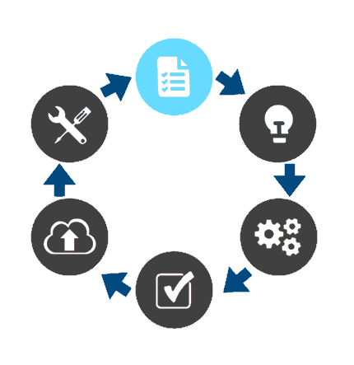
The Interruption
Notes:
You familiarize yourself with the requirements.

Slide 12
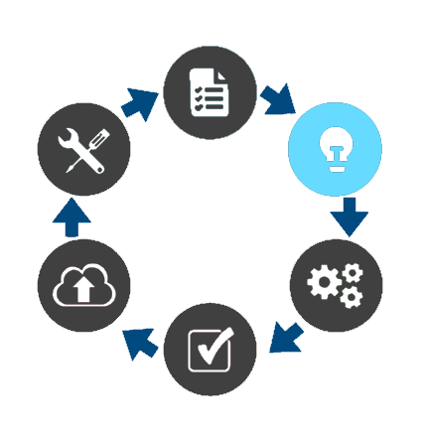
The Interruption
Notes:
You start making decisions about the implementation of a solution.

Slide 13
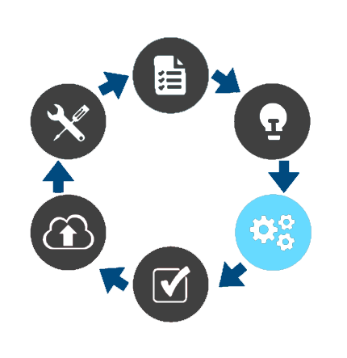
The Interruption
Notes:
You write some code.
But you have a vacation day scheduled the following day. What happens? One of two things:
One: the project waits for you. That’s best case scenario – and we’ll see why in a minute. But what if you have a week off… if you change roles… if you move on to another opportunity. Now waiting becomes problematic.
What’s the alternative? A teammate picks up where you left off.

Slide 14
The Interruption
Notes:
Now she familiarizes herself with the requirements.

Slide 15
The Interruption
Notes:
She disagrees with the direction of the solution.

Slide 16
The Interruption
Notes:
She makes some code changes.
What happens when you get back?

Slide 17
The Interruption
Notes:
You revert her changes?

Slide 18
The Interruption
Notes:
You make some more modifications? Do you see where this is going? We’ve been cycling through the same three steps.

Slide 19
The Interruption
Notes:
Now let’s look at how this plays out in a pairing scenario. You and your pair partner familiarize yourselves with the project or user story.

Slide 20
The Interruption
Notes:
You discuss possible implementations and decide on a direction: We’ll talk more about this process later. But for now, we have an agreed upon solution

Slide 21
The Interruption
Notes:
Together, you write some code. You have tomorrow off. Your teammate can now move forward without you: either by pairing with another teammate, or by continuing alone on the agreed upon direction.

Slide 22
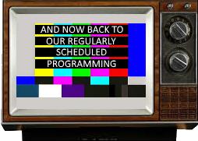
No Interruptions
Notes:
And there are no interruptions.

Slide 23
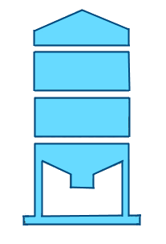
The Silo
Notes:
Story about siloing

Slide 24
The Silo
Notes:
Talk about silo issues

Slide 25

The New Dev
Notes:
Story about onboarding new engineer

Slide 26
The New Dev
Notes:
Talk about onboarding issues

